Slide 1



Honeywell SentinelAI
AI-Powered Behavioral Anomaly Detection for Enterprise Cybersecurity
Presented by : Raj Gaurav
Email:rajgaura327@gmail.com
GitHub:github.com/RajGaurav2691
LinkedIn:linkedin.com/in/raj-gaurav-42124628a/

Slide 2




Problem & Proposed Solution
The Problem
Our Solution: SentinelAI
Traditional SIEM solutions rely on static rules and signatures, resulting in false positives, alert fatigue, and an inability to detect zero-day behavioural attacks.
Behavioural Analytics: Learns normal user baselines.
Isolation Forest: Unsupervised Machine Learning.
Feature Engineering: Contextual data enrichment.
Explainable Risk Score: 0–100 actionable metric.
Threat Vectors:
Credential Theft & Stuffing
SOC Dashboard: Interactive visual interface.
Brute Force Attacks
Impossible Travel
Insider Threat
Key Innovations
Lateral Movement
Detects Zero-Day Threats
Reduces Alert Fatigue
Explainable AI
High Precision Anomaly Detection

Slide 3











Technical Approach
Project Modules
Data Flow Pipeline
generate_data.py
train_model.py
Generates realistic enterprise login events and complex attack scenarios.
Data preprocessing, feature scaling, and Isolation Forest training.
utils.py
dashboard.py
Shared utilities, helper functions, and data validation.
Interactive Streamlit dashboard for SOC analysts.
Machine Learning Pipeline
Feature Engineering
Label Encoding
Standard Scaling
Isolation Forest
Risk Score Mapping

Slide 4










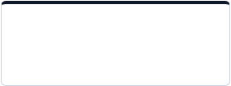
Feasibility & Business Impact
TOTAL LOGIN EVENTS
NORMAL EVENTS
INJECTED ATTACKS
OVERALL ACCURACY
10,000
9,700
300
98%
Evaluation Metrics & Benefits
Challenges & Solutions
PRECISION
RECALL
F1 SCORE
Challenge
Solution
0.67
0.67
0.67
Data Quality
Behaviour Learning
False Positives
Explainable Risk Scoring
Reduced Alert Fatigue & Explainable AI
Cold Start
Continuous Retraining
Enterprise Ready & Lightweight Architecture
Detects Unknown/Zero-Day Threats
Future Roadmap
Phase 1
Phase 2
Phase 3
Phase 4
Deep Learning (Autoencoders & LSTM)
Real-Time Streaming using Apache Kafka
Docker & Kubernetes Deployment
SIEM Integration & Threat Intelligence

Slide 5
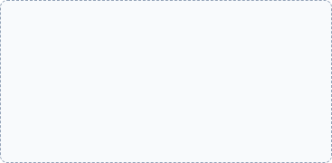
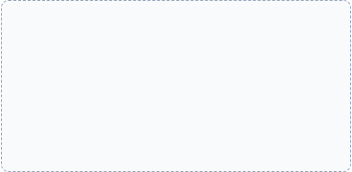











Artifacts
Key architectural components and visual interfaces of the SentinelAI implementation.
End-to-End Pipeline
System Architecture
Streamlit Dashboard
Data flow visualization
Module interaction
Main SOC interface
Threat Analytics
Risk Explorer
Source Code
Trend identification
Deep dive anomalies
GitHub Repository
https://github.com/RajGaurav2691
Project Repository Available Online

Slide 6

Research & References
Core Technologies & Papers
Security Frameworks
Isolation Forest Research Paper (Liu et al.)
MITRE ATT&CK Framework
Scikit-learn Documentation
OWASP Identity Security
Streamlit Documentation
Honeywell Cybersecurity Resources
Pandas & NumPy Documentation
Thank You
Project Repo: https://github.com/RajGaurav2691

